Slide 1
2024 Google Capstone Project
How does a bike-share navigate speedy success
Presented by: Jacques Stephane Jean

Slide 2
Table of contents
Cyclistic case study
Purpose of this case study
Data sources and method
Data presentation and key finding
Recommendations

Slide 3
Purpose
Company
Context and business task
Cyclistic is a company that launched in 2016 a bike-share offering. Customer can buy single-ride, full-day or annual membership
Cyclistic’s finance analyst have concluded that annual membership are much profitable than casual riders.
The company now want to convert casual riders into members
Our business task is to find any trend on how the casual riders and members use cyclistic differently so that the marketing team can design strategies that meet their goals

Slide 4
Data sources and tools used
We used the data source from the company’s data. The previous 12 months of cyclistic data are located at the amazon web service.
https://divvy-tripdata.s3.amazonaws.com/index.html
For cleaning, we used spreadsheet and postgresql
For analysis, we mostly used postgresql to calculate average, count and identify the trends
Spreadsheet chart were used to create the visualizations

Slide 5
Challenges
Challenge 1
Challenge 2
No price data
As we don’t have the casual ride nor annual membership prices, we couldn’t evaluate the outcome of having membership compare to casual for the whole year
No distinct user info
We have data for all ride in 2023 but we couldn’t figure out how many user exactly went for those rides

Slide 6
Data presentation

Slide 7
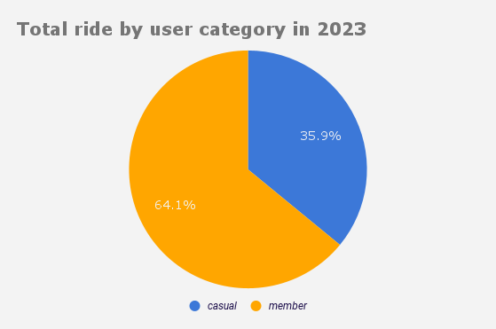
Total ride
We count after cleaning 5,712,887 rides in 2023
2,053,307 rides were made by casuals
3,659,580 rides were made by members

Slide 8
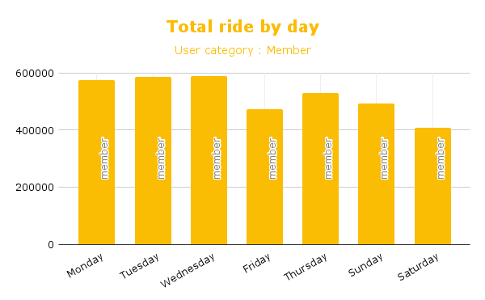
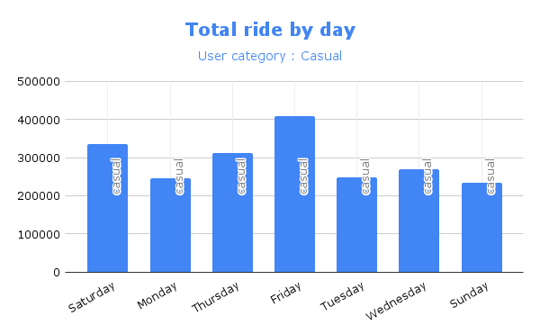
Total ride by day

Slide 9
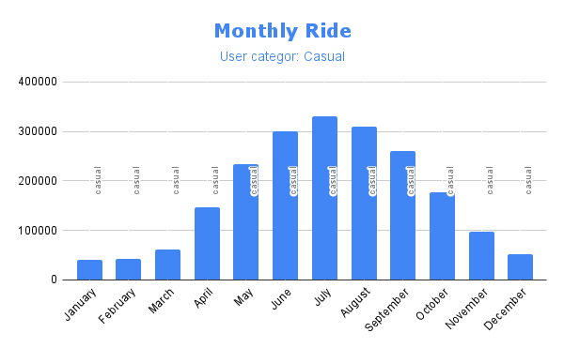
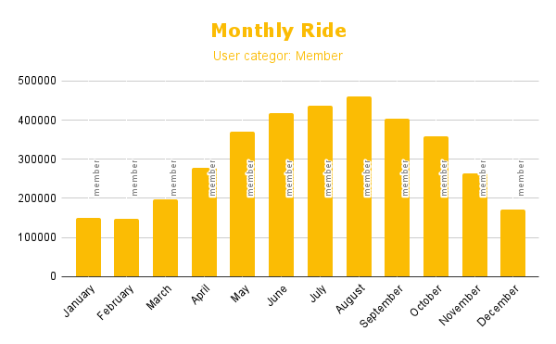
Total ride by month

Slide 10
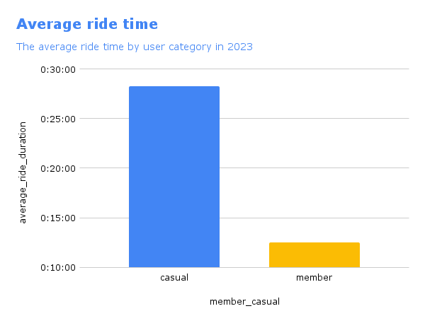
Ride time
Casuals ride way more longer than members
Casuals ride for an average of 28:13
Members ride for an average of 12:31

Slide 11
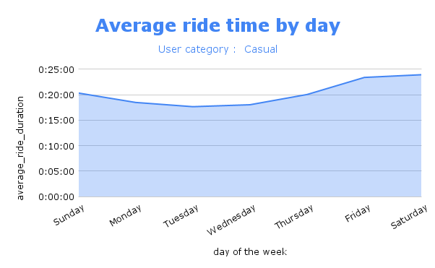
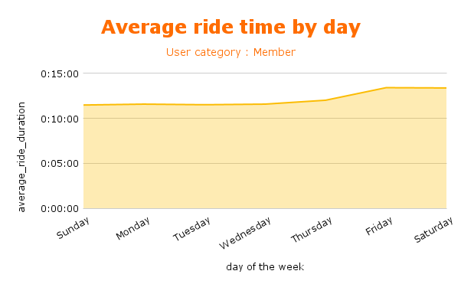
Ride time by day

Slide 12
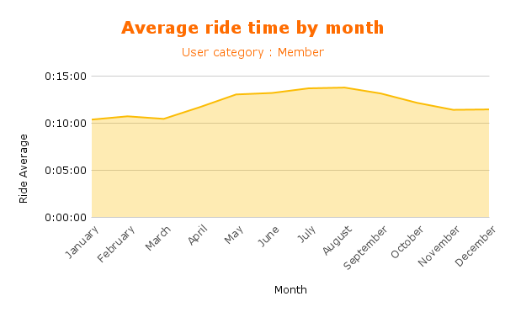
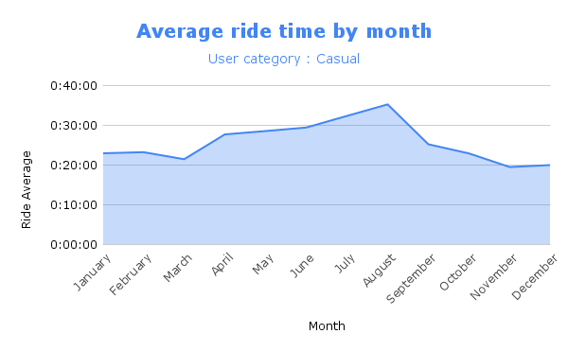
Ride time by month

Slide 13
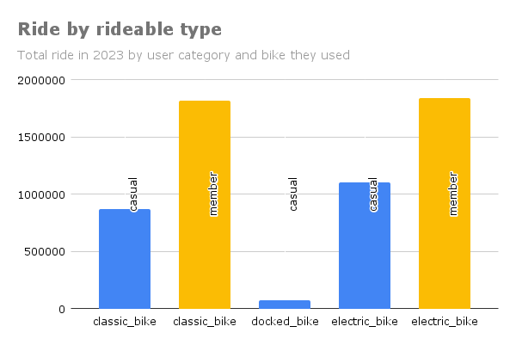
Bike used by customer
Members do not use docked bike while they use classic and electric bike almost evenly
Casuals use all three different bikes, but docked bike are the one least used

Slide 14
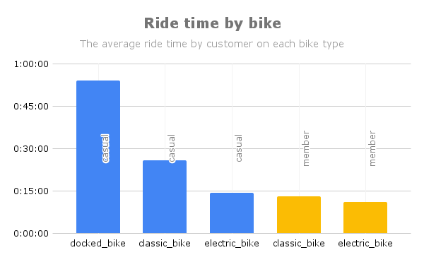
Average ride time on each bike
Casual who use docked bike tend to spend the most time on those rides, more than 50 minutes

Slide 15
Key takeaways
More than 64% of the rides are made by members
Casuals spend more than twice as much time as the members
Although the average ride time is 28 minutes for casual, they spend more than 32 minutes in July and August
There’s no big difference for member on the ride time regarding the month

Slide 16
Key takeaways
Friday and Saturday are the days of the week where the trip last longer for both, casual and members
We register the most ride by members on Wednesday, and Friday for casuals
We register the most ride by Both categories of user during the summer (June, July and August)

Slide 17
Key takeaways
Members do not use docked bike and they use the others almost evenly
Casuals use electric and classic evenly but the few who use docked bike spend the most time on those trips. Those trips have an average of twice the times spent on other bike. (more than 53 minutes)

Slide 18
Recommendations
Get data from individual users to see how many trips a single user made within a month. We could see if a single member is doing way more trips than a casual
Make a survey targeting the casual riders to get their insights on how they appreciate the membership plan and why they use bike share for. We can anticipate that way if a membership plan will fit the need of a casual
Summer time is when we got the most rides, we need to have marketing strategy planned for summer.
More premium subscribers

